Slide 1
NIH CEAL Vaccine Effectiveness FAQs
Last updated 6/1/2021

Slide 2
About This Content
2
The NIH Community Engagement Alliance (CEAL) Against COVID-19 Disparities focuses on addressing misinformation around COVID-19, engaging trusted partners and messengers in the delivery of accurate information, and educating communities on the importance of inclusion in clinical research and its discoveries to overcome COVID-19.
This content showcases CEAL’s new social media tools including individual cards that address many of the questions about comparing vaccines’ effectiveness.
Find additional resources including COVID-19-related fact sheets, infographics, and videos on the CEAL website at covid19community.nih.gov
Content Guide
Vaccine Questions English Slides 5-12
Vaccine Questions Spanish Slides 14-21

Slide 3
Key Digital Resources
3
NIH CEAL Websites #NIHCEAL
English | Spanish
covid19community.nih.gov/ | covid19community.nih.gov/espanol
COVID-19 Related Websites
#ConquerCOVID19 • #COVID19 • #VaccineReady
English | Spanish
NIH COVID-19 covid19.nih.gov/ | NIH COVID-19 salud.nih.gov/
HHS Combat COVID combatcovid.hhs.gov/ | HHS Combate COVID (en español) combatecovid.hhs.gov/
NIH CEAL Event Calendar covid19community.nih.gov/events
NIH CEAL eNewsletter Subscription go.usa.gov/xAsax

Slide 4
Vaccine Effectiveness Questions English Assets
4
Share these resources on your social media channels. They answer the following questions:
Which COVID-19 vaccines help keep you from needing to go to the hospital or dying from COVID-19?
Are any of the current COVID-19 vaccines safer than others?
Is it better to get a COVID-19 mRNA or viral vector vaccine?
Which COVID-19 vaccine gives the best protection?
Which of the current COVID-19 vaccines requires ONE dose?
Which of the current COVID-19 vaccines require TWO doses?
Which vaccine is best to get?
What’s the best way to keep from getting sick with COVID-19?

Slide 5
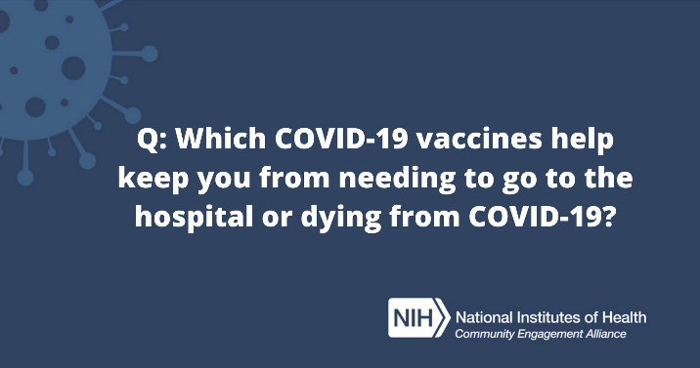
Which COVID-19 vaccines help keep you from needing to go to the hospital or dying from COVID-19?
5
POST COPY
Facebook/LinkedIn
All COVID-19 vaccines were nearly 100% effective at preventing hospitalization and death from COVID-19, which is one of the most important things to consider. Get more questions answered: https://go.usa.gov/xHbAG
Twitter/Instagram
All #COVID19 vaccines were nearly 100% effective at preventing both hospitalization and death. More questions answered: https://go.usa.gov/xHbAG #NIHCEAL
IMAGES
Download Images https://covid19community.nih.gov/resources/vaccine-effectiveness-social-cards

Slide 6
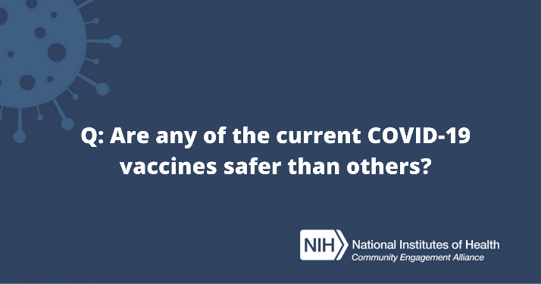
Are any of the current COVID-19 vaccines safer than others?
6
POST COPY
Facebook/LinkedIn
All of the current COVID-19 vaccines are safe and effective against COVID-19. Get more questions answered: https://go.usa.gov/xHbAG
Twitter/Instagram
All of the current #COVID19 vaccines are safe and effective against COVID-19. Get more questions answered: https://go.usa.gov/xHbAG #NIHCEAL #VaccineReady
IMAGES
Download Images https://covid19community.nih.gov/resources/vaccine-effectiveness-social-cards

Slide 7
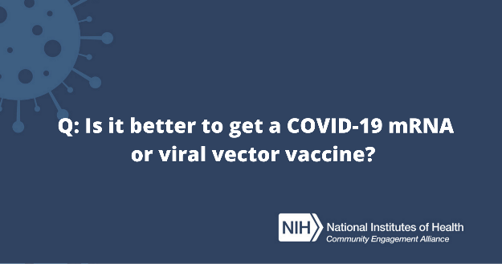
Is it better to get a COVID-19 mRNA or viral vector vaccine?
7
POST COPY
Facebook/LinkedIn
Plan to take the COVID-19 vaccine that is available to you first. All of the vaccines are very effective at keeping you from getting very sick with COVID-19, which is one of the most important things to consider. https://go.usa.gov/xHbAG
Twitter/Instagram
All #COVID19 vaccines are effective at keeping you from getting very sick with COVID-19, which is one of the most important things to consider. https://go.usa.gov/xHbAG #NIHCEAL #VaccineReady
IMAGES
Download Images https://covid19community.nih.gov/resources/vaccine-effectiveness-social-cards

Slide 8
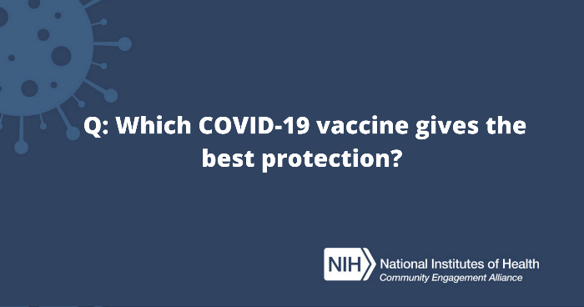
Which COVID-19 vaccine gives the best protection?
8
POST COPY
Facebook/LinkedIn
It isn’t possible to say one type of vaccine will protect you better than another since the vaccines were not compared to one another in a single trial. Clinical trials for each vaccine defined and measured efficacy, or how successful each vaccine was at protecting trial participants from getting sick, and from getting very sick, at different points in time. https://go.usa.gov/xHbAG
Twitter/Instagram
It isn’t possible to say one #COVID19 vaccine protects better than another. Efficacy, or how well each vaccine protected people in a trial, were measured differently in each trial. https://go.usa.gov/xHbAG #NIHCEAL
IMAGES
Download Images https://covid19community.nih.gov/resources/vaccine-effectiveness-social-cards

Slide 9
Which of the current COVID-19 vaccines requires one dose?
9
POST COPY
Facebook/LinkedIn
The Johnson & Johnson COVID-19 Vaccine requires only one dose. Get more vaccine questions answered: https://go.usa.gov/xHbAG
Twitter/Instagram
The Johnson & Johnson #COVID19 vaccine requires only one dose. Get more vaccine questions answered: https://go.usa.gov/xHbAG #NIHCEAL #VaccineReady
IMAGES
Download Images https://covid19community.nih.gov/resources/vaccine-effectiveness-social-cards

Slide 10
Which of the current COVID-19 vaccines require two doses?
10
POST COPY
Facebook/LinkedIn
Two of the current COVID-19 vaccines require two doses – Moderna Covid-19 Vaccine and Pfizer-BioNTech COVID-19 Vaccine. Get more vaccine questions answered: https://go.usa.gov/xHbAG
Twitter/Instagram
Two of the current #COVID19 vaccines require two doses – Moderna Covid-19 Vaccine and Pfizer-BioNTech COVID-19 Vaccine. Get more vaccine questions answered: https://go.usa.gov/xHbAG #NIHCEAL #VaccineReady
IMAGES
Download Images https://covid19community.nih.gov/resources/vaccine-effectiveness-social-cards
Notes:
Social media card. Answer: Two of them. Moderna Covid-19 Vaccine and Pfizer-BioNTech COVID-19 Vaccine. More vaccine questions answered at covid19community.nih.gov

Slide 11
Which vaccine is the best to get?
11
POST COPY
Facebook/LinkedIn
Plan to take the COVID-19 vaccine that is available to you first. One of the best ways to protect yourself, your family and your community is to get vaccinated as soon as possible. Get more questions answered: https://go.usa.gov/xHbAG
Twitter/Instagram
Take the #COVID19 vaccine that is available to you. Getting vaccinated as soon as possible is one of the best ways to protect yourself, your family and your community. https://go.usa.gov/xHbAG #NIHCEAL
IMAGES
Download Images https://covid19community.nih.gov/resources/vaccine-effectiveness-social-cards

Slide 12
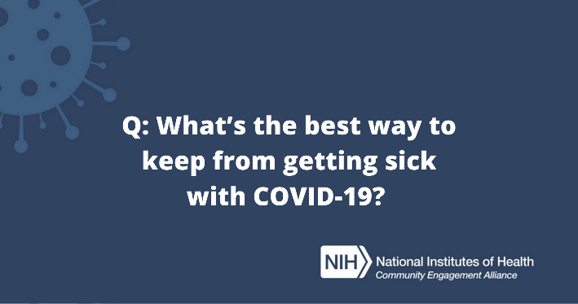
What’s the best way to keep from getting sick with COVID-19?
12
POST COPY
Facebook/LinkedIn
Get vaccinated as soon as a COVID-19 vaccine is available to you. When you’ve been fully vaccinated, follow guidance from the CDC about the best ways to protect yourself and others. https://go.usa.gov/xHbAG
Twitter/Instagram
Get vaccinated as soon as you can. When you’ve been fully vaccinated, follow CDC guidance for the best ways to protect yourself and others. https://go.usa.gov/xHbAG #NIHCEAL
IMAGES
Download Images https://covid19community.nih.gov/resources/vaccine-effectiveness-social-cards

Slide 13
Vaccine Effectiveness Questions Spanish Assets
13
Share these resources on your social media channels. They answer the following questions:
¿Cuáles vacunas contra el COVID-19 ayudan a evitar tener la hospitalización o muerte por COVID?
¿Alguna de las vacunas disponibles contra el COVID-19 es más segura que las otras?
¿Es mejor recibir una vacuna de ARNm o una vacuna de vector viral contra el COVID-19?
¿Qué vacuna contra el COVID-19 brinda la mejor protección?
¿Cuál de las vacunas contra el COVID-19 requiere UNA SOLA dosis?
¿Cuáles de las vacunas disponibles contra el COVID-19 requieren dos dosis?
¿Cuál es la mejor vacuna que puedo recibir?
¿Cuál es la mejor manera de evitar enfermarse con COVID-19?

Slide 14
¿Cuáles vacunas contra el COVID-19 ayudan a evitar tener la hospitalización o muerte por COVID?
14
POST COPY
Facebook/LinkedIn
Todas las vacunas contra el COVID-19 tienen casi un 100% de efectividad para prevenir la hospitalización y la muerte por COVID-19, que es una de las cosas más importantes a considerar. Obtenga más respuestas a sus preguntas: https://go.usa.gov/xA6h2
Twitter/Instagram
Todas las vacunas contra el #COVID19 tuvieron casi un 100% de efectividad para prevenir tanto la hospitalización como la muerte. Encuentre más respuestas a preguntas sobre las vacunas: https://go.usa.gov/xA6h2 #NIHCEAL
IMAGES
Download Images https://covid19community.nih.gov/resources/vaccine-effectiveness-social-cards

Slide 15
¿Alguna de las vacunas disponibles contra el COVID-19 es más segura que las otras?
15
POST COPY
Facebook/LinkedIn
Todas las vacunas disponibles son seguras y efectivas contra el COVID-19. Obtenga más respuestas a sus preguntas: https://go.usa.gov/xA6h2
Twitter/Instagram
Todas las vacunas disponibles son seguras y efectivas contra el #COVID19. Obtenga más respuestas a sus preguntas: https://go.usa.gov/xA6h2 #NIHCEAL
IMAGES
Download Images https://covid19community.nih.gov/resources/vaccine-effectiveness-social-cards

Slide 16
¿Es mejor recibir una vacuna de ARNm o una vacuna de vector viral contra el COVID-19?
16
POST COPY
Facebook/LinkedIn
Planifique recibir la vacuna contra el COVID-19 que más rápido esté disponible para usted. Todas las vacunas son muy efectivas para evitar que se enferme gravemente por COVID-19, esto es una de las cosas más importantes que debe considerar. https://go.usa.gov/xA6h2
Twitter/Instagram
Todas las vacunas contra el #COVID19 son efectivas para evitar que se enferme gravemente por COVID-19, esto es una de las cosas más importantes que debe considerar. https://go.usa.gov/xA6h2 #NIHCEAL
IMAGES
Download Images https://covid19community.nih.gov/resources/vaccine-effectiveness-social-cards

Slide 17
¿Qué vacuna contra el COVID-19 brinda la mejor protección?
17
POST COPY
Facebook/LinkedIn
No es posible decir que un tipo de vacuna lo protegerá mejor que otra, ya que las vacunas no se compararon entre sí en un solo ensayo. Los ensayos clínicos para cada vacuna definieron y midieron la eficacia o el éxito de cada vacuna para proteger a los participantes del ensayo de enfermarse y de enfermarse gravemente en diferentes momentos. https://go.usa.gov/xA6h2
Twitter/Instagram
No es posible decir que una vacuna protege mejor que otra. La eficacia, o qué tan bien protegió cada vacuna a las personas en un ensayo, se midió de manera diferente en cada uno de ellos. https://go.usa.gov/xA6h2 #NIHCEAL
IMAGES
Download Images https://covid19community.nih.gov/resources/vaccine-effectiveness-social-cards

Slide 18
¿Cuál de las vacunas contra el COVID-19 requiere UNA SOLA dosis?
18
POST COPY
Facebook/LinkedIn
¿Cuál de las vacunas disponibles contra el COVID-19 requiere una dosis? Solo una, la vacuna de Johnson & Johnson. Obtenga respuestas a más preguntas comunes sobre las vacunas: https://go.usa.gov/xA6h2
Twitter/Instagram Copy
¿Cuál de las vacunas disponibles contra el #COVID19 requiere solo una dosis? Solo una, la vacuna de Johnson & Johnson. Obtenga respuestas a más preguntas sobre las vacunas: https://go.usa.gov/xA6h2 #NIHCEAL
IMAGES
Download Images https://covid19community.nih.gov/resources/vaccine-effectiveness-social-cards

Slide 19
¿Cuáles de las vacunas disponibles contra el COVID-19 requieren dos dosis?
19
POST COPY
Facebook/LinkedIn
¿Cuáles de las vacunas disponibles contra el COVID-19 requieren dos dosis? Hay dos, la vacuna contra el COVID-19 de Moderna y la de Pfizer-BioNTech. Obtenga respuestas a más preguntas sobre las vacunas: https://go.usa.gov/xA6h2
Twitter/Instagram Copy
¿Cuáles de las vacunas disponibles contra el #COVID19 requieren dos dosis? Hay dos, la vacuna contra el COVID-19 de Moderna y la de Pfizer-BioNTech. Obtenga respuestas a más preguntas sobre las vacunas: https://go.usa.gov/xA6h2 #NIHCEAL
IMAGES
Download Images https://covid19community.nih.gov/resources/vaccine-effectiveness-social-cards

Slide 20
¿Cuál es la mejor vacuna que puedo recibir?
20
POST COPY
Facebook/LinkedIn
¿Qué vacuna contra el COVID-19 es mejor recibir? Planifique recibir la vacuna que más rápido esté disponible para usted. Una de las mejores formas de protegerse a sí mismo, a su familia y a su comunidad es vacunarse lo antes posible. Obtenga más respuestas a sus preguntas: https://go.usa.gov/xA6h2
Twitter/Instagram
Reciba la vacuna contra el #COVID19 que esté disponible para usted. Vacunarse lo antes posible es una de las mejores formas de protegerse a usted mismo, a su familia y a su comunidad. https://go.usa.gov/xA6h2 #NIHCEAL
IMAGES
Download Images https://covid19community.nih.gov/resources/vaccine-effectiveness-social-cards

Slide 21
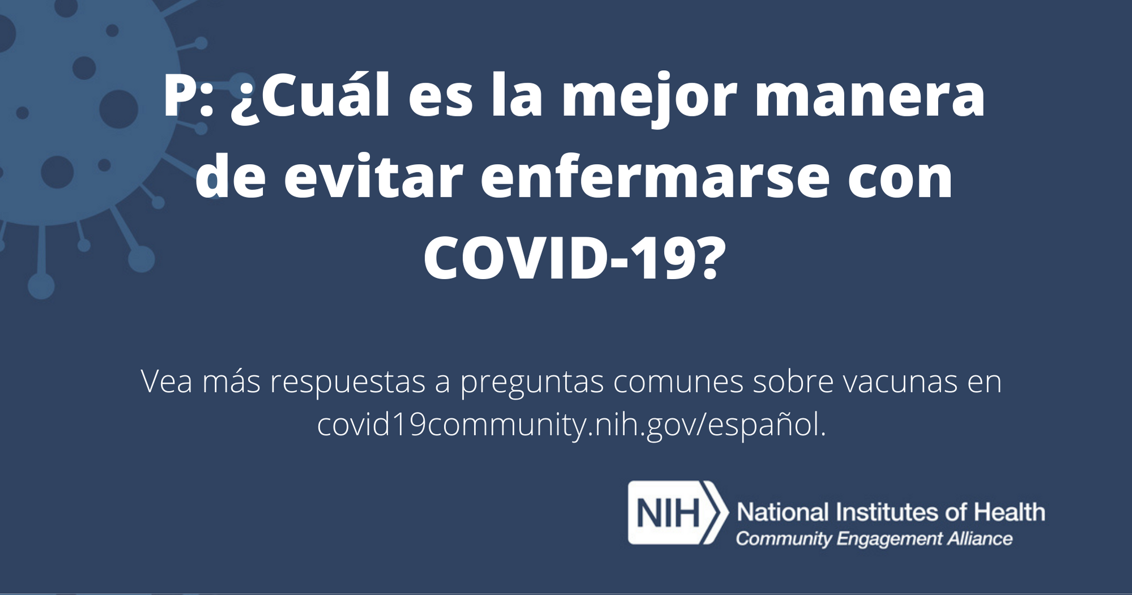
¿Cuál es la mejor manera de evitar enfermarse con COVID-19?
21
POST COPY
Facebook/LinkedIn
Vacúnese tan pronto como tenga una vacuna contra el COVID-19 disponible. Cuando esté completamente vacunado, siga las recomendaciones de los CDC sobre las mejores formas de protegerse y proteger a los demás. https://go.usa.gov/xA6h2
Twitter/Instagram
Vacúnese lo antes posible. Cuando esté completamente vacunado, siga las recomendaciones de los CDC sobre las mejores formas de protegerse a usted mismo y proteger a los demás. https://go.usa.gov/xA6h2 #NIHCEAL
IMAGES
Download Images https://covid19community.nih.gov/resources/vaccine-effectiveness-social-cards

