Slide 1
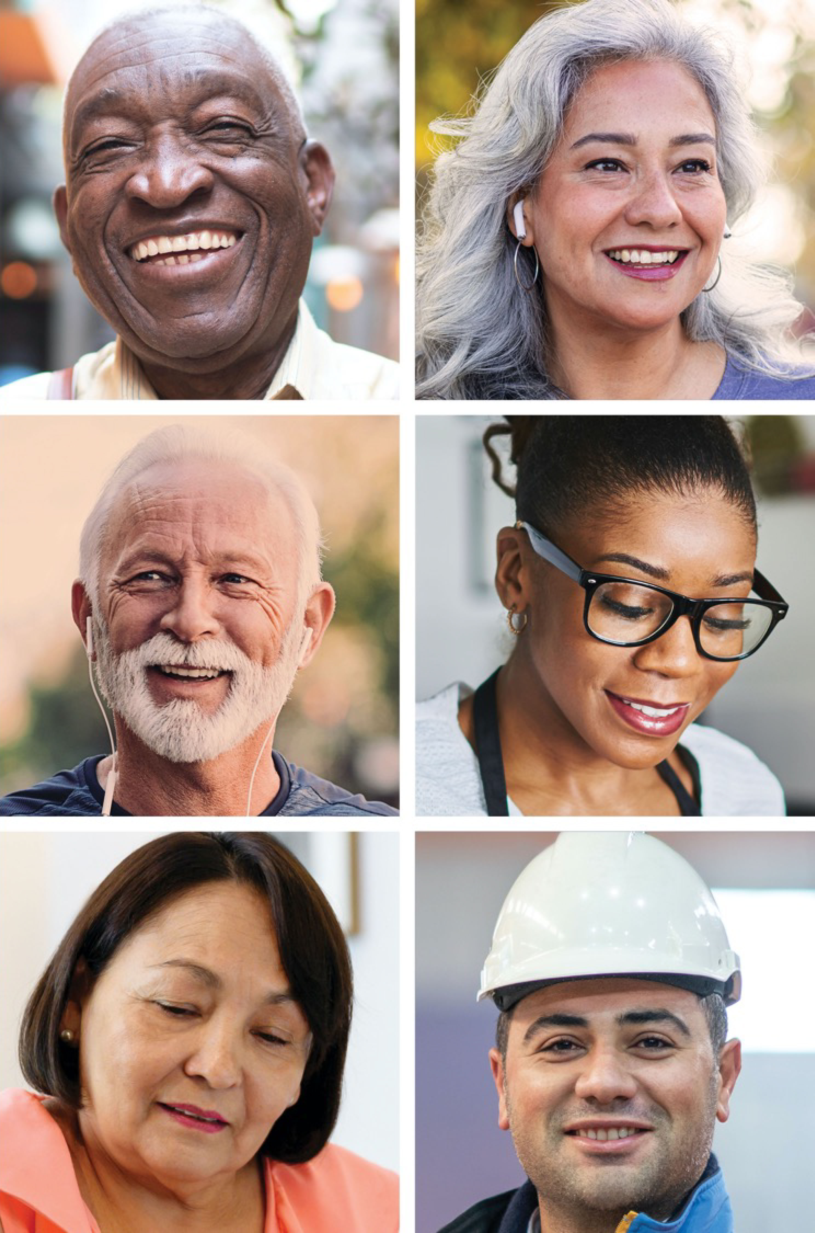
NIH CEAL Content Toolkit
Last updated 4/19/2021

Slide 2
About This Toolkit
2
The NIH Community Engagement Alliance (CEAL) Against COVID-19 Disparities focuses on addressing misinformation around COVID-19, engaging trusted partners and messengers in the delivery of accurate information, and educating communities on the importance of inclusion in clinical research and its discoveries to overcome COVID-19.
This toolkit showcases CEAL’s newly-launched Scientific Pathway, which spotlights some of the diverse leaders who have contributed to COVID-19 research and treatment and emphasizes that safety always guides research.
Find additional resources including COVID-19-related fact sheets, infographics, and videos on the CEAL website at covid19community.nih.gov
Content Guide
For Scientific Pathway infographics, see Slides 7-9.
For Scientific Pathway social media, see Slides 10-21.

Slide 3
Key Digital Resources
3
NIH CEAL Websites #NIHCEAL
English | Spanish
covid19community.nih.gov/ | covid19community.nih.gov/espanol
COVID-19 Related Websites
#ConquerCOVID19 • #COVID19 • #VaccineReady
English | Spanish
NIH COVID-19 covid19.nih.gov/ | NIH COVID-19 salud.nih.gov/
HHS Combat COVID combatcovid.hhs.gov/ | HHS Combate COVID (en español) combatecovid.hhs.gov/
NIH CEAL Event Calendar covid19community.nih.gov/events
NIH CEAL eNewsletter Subscription go.usa.gov/xAsax

Slide 4
Scientific Pathway
4
Safety always guides the scientific pathway toward vaccines and treatments. Safety steers scientific leaders who review and fund research, informs recruitment of volunteers who partner with researchers and participate in clinical trials, frames the rigorous and continuous oversight of studies, determines regulatory approval, guides engagement efforts in communities, and directs doctors and nurses who bring discoveries to patients. At each step on the pathway, we can find a diverse group of people who are working every day to help us conquer the COVID-19 pandemic.
Meet Scientific Pathway leaders and find quotes about their work at https://covid19community.nih.gov/about/scientific-pathway. Leaders featured in the pathway are also listed on the next two slides.

Slide 5
Featured Scientific Pathway Leaders
5
Public Health Funders | Safety Monitors
Dr. Gary H. Gibbons, Director, National Heart, Lung, and Blood Institute Dr. Eliseo J. Pérez Stable, Director, National Institute on Minority Health and Health Disparities | Dr. Lisa A. Cooper, Bloomberg Distinguished Professor, Johns Hopkins Bloomberg School of Public Health Dr. Jaime G. Deville, Clinical Professor of Pediatrics, Division of Infectious Diseases, David Geffen School of Medicine; Director of the Care-4-Families Clinic, University of California, Los Angeles, UCLA Mattel Children’s Hospital Dr. Jennifer Knight-Madden, Professor of Pediatric Pulmonology & Clinical Research; Director, Sickle Cell Unit, The Caribbean Institute for Health Research, The University of the West Indies Ysabel Duron, President/Executive Director, The Latino Cancer Institute
Researchers
Dr. Kizzmekia S. Corbett, Viral Immunologist and Research Fellow, Vaccine Research Center, National Institute of Allergy and Infectious Diseases
Dr. Katya Corado, Investigator, The Lundquist Institute
Dr. Njira Lucia Lugogo, Pulmonologist, Clinical Associate Professor of Internal Medicine, Asthma Program Director, Division of Pulmonary & Critical Care Medicine, University of Michigan

Slide 6
Featured Scientific Pathway Leaders
6
Volunteers | Care Providers
Geraldine Bradshaw, School Principal Emelina Asto-Flores, CaRE2 Community Health Educator with CEAL, College of Pharmacy, University of Florida Mir Majeed, Volunteer Participant Dr. Richard Moye, Associate Professor of Sociology, Chair of Department of Behavioral Sciences, Winston-Salem State University Dr. Keisha L. Gibson, Associate Professor of Medicine and Pediatrics, DOM Vice Chair of Diversity of Inclusion, Chief, Pediatric Nephrology, UNC Kidney Center, University of North Carolina at Chapel Hill Dr. Craig E. Cameron, Jeffrey Houpt Distinguished Investigator, Professor and Chair, Department of Microbiology and Immunology, School of Medicine, University of North Carolina at Chapel Hill Dr. Connie Arnold, Professor of Medicine, Louisiana State University Health Shreveport | Dr. Cydney Teal, Chair, Department of Family & Community Medicine, Service Line Leader, Primary Care & Community Medicine Service Line, ChristianaCare Dr. Felix M. Valbuena, Jr., Chief Executive Officer, Community Health And Social Services Center Tabe Mase, Director of Employee Health Services, ChristianaCare Health System Dr. MeiLan Han, Professor, Internal Medicine, Division of Pulmonary and Critical Care, University of Michigan Dr. Paule V. Joseph, Lasker Clinical Research Scholar, Tenure-Track Investigator (Clinical), Principal Investigator, NIH Distinguished Scholar, Sensory Science and Metabolism Unit, Biobehavioral Branch, Division of Intramural Research Dr. Carolyn Allen, Family Nurse Practitioner, National Institute for Nursing Research, Division of Intramural Research Dr. Robert Gillespie, Cardiologist, Sharp HealthCare Monica Atkinson, Research Nurse, Nurse Coordinator, Section of Sensory Science and Metabolism, National Institute for Nursing Research, Division of Intramural Research Dr. Alejandra Casillas, Assistant Professor of Medicine in Residence, Division of General Internal Medicine and Health, Services Research, Department of Medicine, David Geffen School of Medicine, University of California, Los Angeles Dr. Yelba M. Castellon-Lopez, Assistant Professor, Department of Family Medicine, David Geffen School of Medicine, University of California, Los Angeles Dr. Chyke A. Doubeni, Professor of Family Medicine, Center for Health Equity and Community, Engagement Research, Mayo Clinic Cancer Center, Center for Clinical and Translational Science, Mayo Clinic

Slide 7
Scientific Pathway Infographics
7
Share these resources on your website, newsletters, and bulletins.

Slide 8
Diversity in COVID-19 Science
8
Download English

Slide 9
Diversidad en la ciencia contra el COVID-19
9
Download Spanish

Slide 10
Social Media Content Scientific Pathway English Assets
10
Share these resources on your social media channels.
Social Media Cards
Dr. Felix Valbuena
Dr. Katya Corado
Dr. Lisa Cooper
Dr. Chyke Doubeni
Emelina Asto-Flores

Slide 11
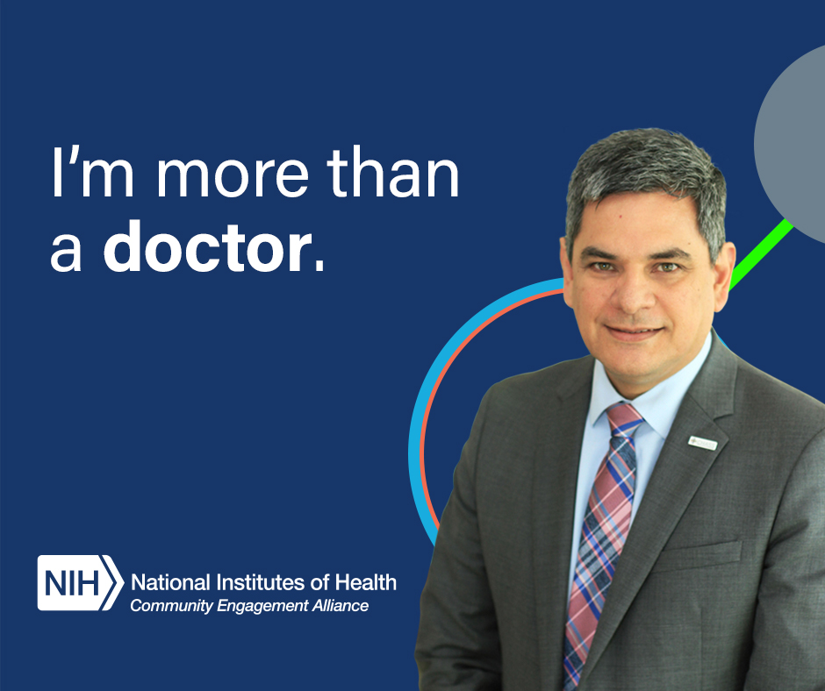
Dr. Felix Valbuena CARE PROVIDER
11
POST COPY – ENGLISH
Facebook/LinkedIn
This is Dr. Felix Valbuena, a Colombian-American family doctor who personally vaccinated his 80-year-old parents. Learn about him and others on the pathway from discovery to treatment: http://go.usa.gov/xHTsy
Twitter Copy 1
This is Dr. Felix Valbuena, a Colombian-American family doctor who personally vaccinated his 80-year-old parents. Learn about him and others on the pathway from discovery to treatment: http://go.usa.gov/xHTsy
Twitter Copy 2
This is Dr. Felix Valbuena, a Colombian-American family doctor who personally vaccinated his 80-year-old parents. Learn more about diversity in #COVID19 science: http://go.usa.gov/xHTsy #NIHCEAL
IMAGE OPTIONS
IMAGE ALT TEXT
Facebook/Twitter
Text reads: “I’m more than a doctor.”
Right side graphics: Dr. Felix Valbuena’s headshot with abstract illustration of a molecule behind it.
Logo: The National Institutes of Health Community Engagement Alliance program
LinkedIn
Image of Dr. Felix Valbuena that reads “I’m more than a doctor.” NIH’s Community Engagement Alliance logo
Download Facebook/LinkedIn image
Twitter image

Slide 12
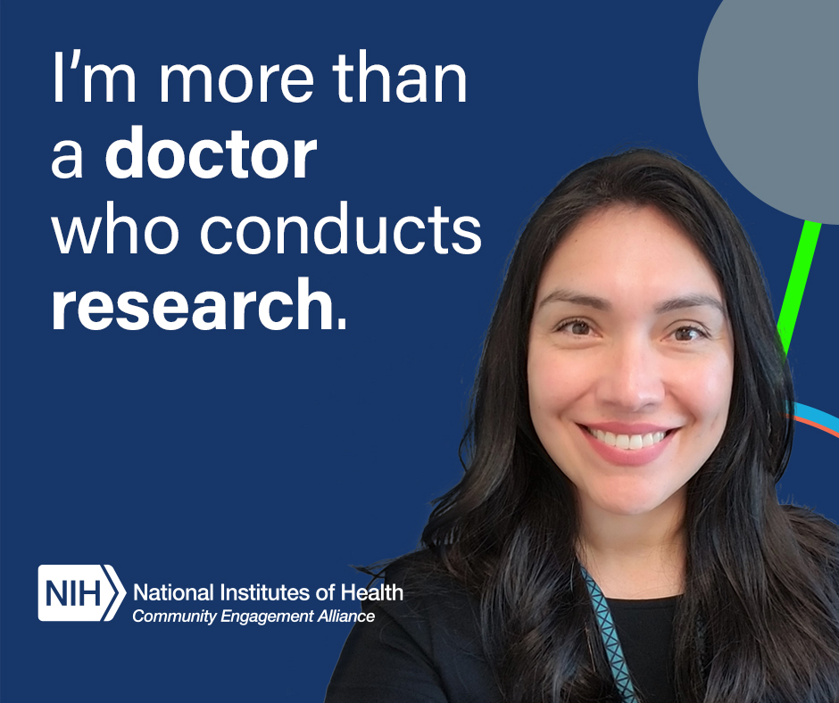
Dr. Katya Corado RESEARCHER
12
POST COPY – ENGLISH
Facebook/LinkedIn
This is Dr. Katya Corado. She’s a neighbor who shares with her community how science and COVID-19 vaccines work. Learn more about diversity in COVID-19 science: http://go.usa.gov/xHTsy
Twitter Copy 1
This is Dr. Katya Corado. She’s a neighbor who shares with her community how science and #COVID19 vaccines work. Learn more about her and others on the pathway from discovery to treatment: http://go.usa.gov/xHTsy #NIHCEAL #VaccineReady
Twitter Copy 2
This is Dr. Katya Corado. She’s a neighbor who shares with her community how science and #COVID19 vaccines work. Learn more about diversity in COVID-19 science: http://go.usa.gov/xHTsy #NIHCEAL #VaccineReady
IMAGE OPTIONS
IMAGE ALT TEXT
Facebook/Twitter
Text reads: “I’m more than a doctor who conducts research.”
Right side graphics: Dr. Katya Corado’s headshot with abstract illustration of a molecule behind it.
Logo: The National Institutes of Health Community Engagement Alliance program
LinkedIn
Image of Dr. Katya Corado that reads “I’m more than a doctor who conducts research.”
Download Facebook/LinkedIn image
Twitter image

Slide 13
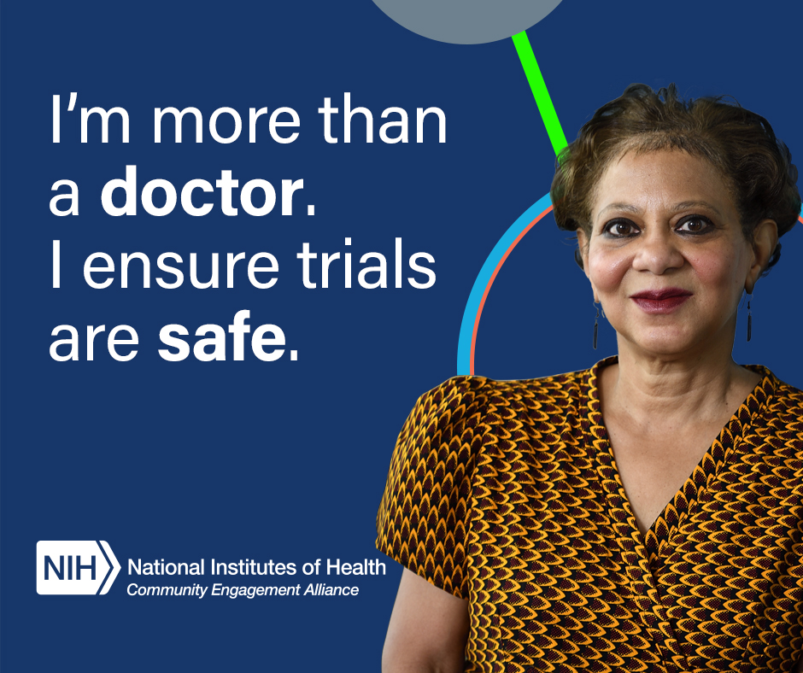
Dr. Lisa Cooper SAFETY MONITOR
13
POST COPY – ENGLISH
Facebook/LinkedIn
Dr. Lisa Cooper, daughter of a Liberian immigrant, reviews vaccine data. She can assure our parents vaccines are safe. Learn more about diversity in COVID19 science: http://go.usa.gov/xHTsy
Twitter Copy 1
Dr. Lisa Cooper, daughter of a Liberian immigrant, reviews vaccine data. She can assure our parents vaccines are safe. Learn more about her and others on the pathway from discovery to treatment: http://go.usa.gov/xHTsy #NIHCEAL #VaccineReady
Twitter Copy 2
Dr. Lisa Cooper, daughter of a Liberian immigrant, reviews vaccine data. She can assure our parents vaccines are safe. Learn more about her and others on the pathway from discovery to treatment: http://go.usa.gov/xHTsy #NIHCEAL #VaccineReady
IMAGE OPTIONS
IMAGE ALT TEXT
Facebook/Twitter
Text reads: “I’m more than a doctor. I ensure trials are safe.”
Right side graphics: Dr Lisa Cooper’s headshot with abstract illustration of a molecule behind it.
Logo: The National Institutes of Health Community Engagement Alliance program
LinkedIn
Image of Dr. Lisa Cooper that reads “I’m more than a doctor. I ensure trials are safe.”
Download Facebook/LinkedIn image
Twitter image

Slide 14
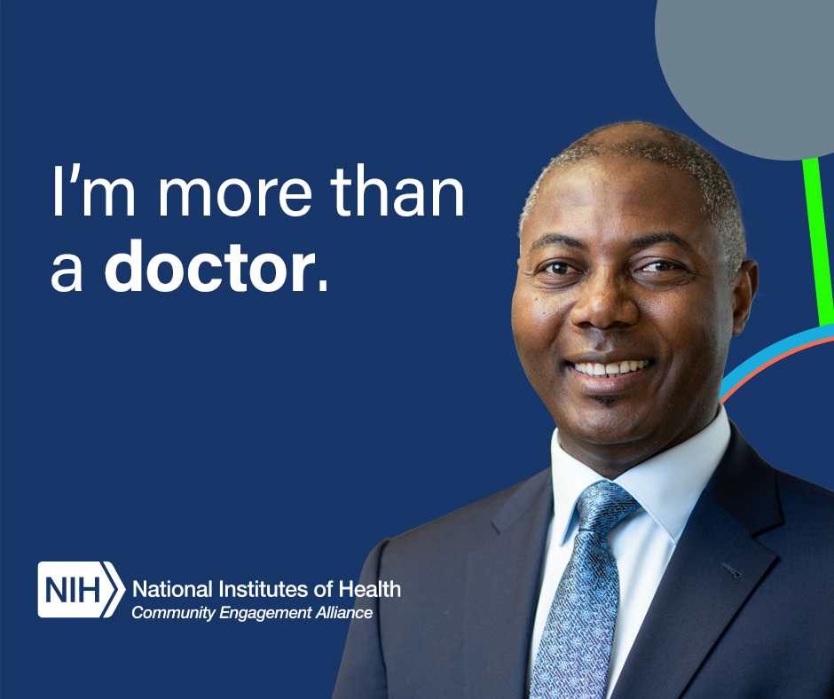
Dr. Chyke Doubeni CARE PROVIDER
14
POST COPY – ENGLISH
Facebook/LinkedIn
Dr. Chyke Doubeni, a Nigerian-American, volunteered for a COVID-19 trial and can address his patients’ concerns firsthand. Learn more about him and others on the pathway from discovery to treatment: http://go.usa.gov/xHTsy
Twitter Copy 1
Dr. Chyke Doubeni, a Nigerian-American, volunteered for a #COVID19 trial and can address his patients’ concerns firsthand. Learn more about diversity in #COVID19 science: http://go.usa.gov/xHTsy #NIHCEAL
Twitter Copy 2
Dr. Chyke Doubeni, a Nigerian-American, volunteered for a #COVID19 trial and can address his patients’ concerns firsthand. Learn about him and others on the pathway from discovery to treatment: http://go.usa.gov/xHTsy #NIHCEAL
IMAGE OPTIONS
IMAGE ALT TEXT
Facebook/Twitter
Text reads: “I’m more than a doctor.”
Right side graphics: Dr. Chyke Doubeni’s headshot with abstract illustration of a molecule behind it.
Logo: The National Institutes of Health Community Engagement Alliance program
LinkedIn
Image of Dr. Chyke Doubeni that reads “I’m more than a doctor.” NIH’s Community Engagement Alliance logo.
Download Facebook/ LinkedIn image
Twitter image

Slide 15
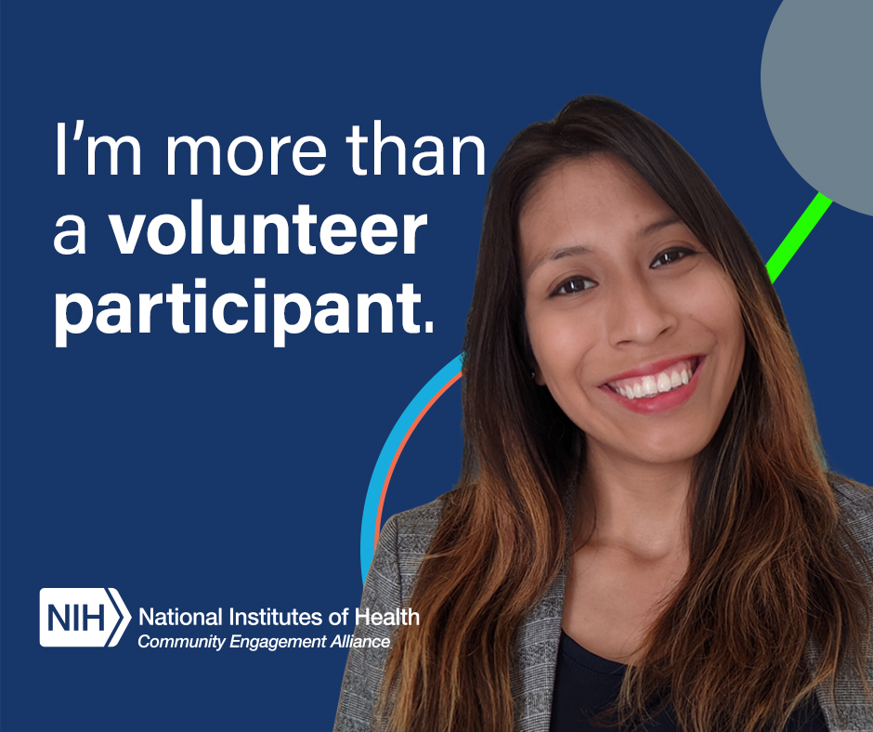
Emelina Asto-Flores VOLUNTEER
15
POST COPY – ENGLISH
Facebook/LinkedIn
Emelina Asto-Flores, a Peruvian-American, volunteered for a clinical trial and inspired her grandmother to get vaccinated. Learn about her and others on the pathway from discovery to treatment: http://go.usa.gov/xHTsy
Twitter Copy 1
Emelina Asto-Flores, a Peruvian-American, volunteered for a clinical trial and inspired her grandmother to get vaccinated. Learn more about her and others on the pathway from discovery to treatment: http://go.usa.gov/xHTsy #NIHCEAL #VaccineReady
Twitter Copy 2
Emelina Asto-Flores, a Peruvian-American, volunteered for a clinical trial and inspired her grandmother to get vaccinated. Learn more about diversity in #COVID19 science: http://go.usa.gov/xHTsy #NIHCEAL #VaccineReady
IMAGE OPTIONS
IMAGE ALT TEXT
Facebook/Twitter
Text reads: “I’m more than a volunteer participant.”
Right side graphics: Emelina Asto-Flores’s headshot with abstract illustration of a molecule behind it.
Logo: The National Institutes of Health Community Engagement Alliance program
LinkedIn
Image of Emelina Asto-Flores that reads “I’m more than a volunteer participant.”
Download Facebook/ LinkedIn image
Twitter image

Slide 16
Social Media Content Scientific Pathway Spanish Assets
16
Share these resources on your social media channels.
Social Media Cards
Dr. Felix Valbuena
Dr. Katya Corado
Dr. Lisa Cooper
Dr. Chyke Doubeni
Emelina Asto-Flores

Slide 17
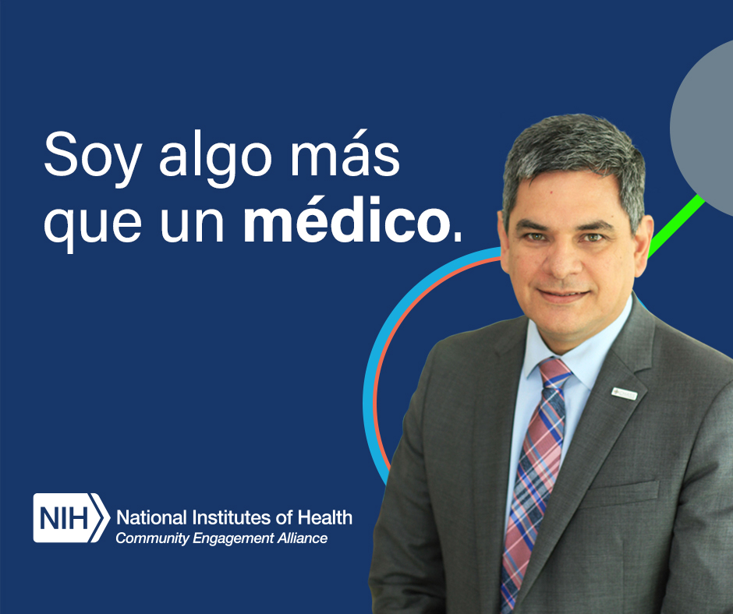
Dr. Felix Valbuena CARE PROVIDER
17
POST COPY – SPANISH
Facebook/LinkedIn
Este es el doctor Félix Valbuena, un médico de familia colombo americano que vacunó personalmente a sus padres de 80 años. Aprenda más sobre él y otras personas que participan en el proceso desde el descubrimiento hasta el tratamiento: https://go.usa.gov/xHjBZ
Twitter Copy 1
Este es el doctor Felix Valbuena, un médico de familia colombo americano que vacunó personalmente a sus padres de 80 años. Aprenda más sobre él y otras personas que participan en el proceso desde el descubrimiento hasta el tratamiento: https://go.usa.gov/xHjBZ #NIHCEAL
Twitter Copy 2
Este es el doctor Felix Valbuena, un médico de familia colombo americano que vacunó personalmente a sus padres de 80 años. Aprenda más sobre la diversidad en la ciencia contra el #COVID19: https://go.usa.gov/xHjBZ #NIHCEAL
IMAGE OPTIONS
IMAGE ALT TEXT
Facebook/Twitter
El texto dice: “Soy más que un médico”.
Gráficos del lado derecho: foto del Dr. Félix Valbuena con una ilustración abstracta de una molécula detrás.
Logotipo: La Alianza de Participación Comunitaria de los Institutos Nacionales de Salud (en inglés)
LinkedIn
Imagen del Dr. Félix Valbuena que dice "Soy más que un médico". La Alianza de Participación Comunitaria de los NIH.
Download Facebook image
Twitter image

Slide 18
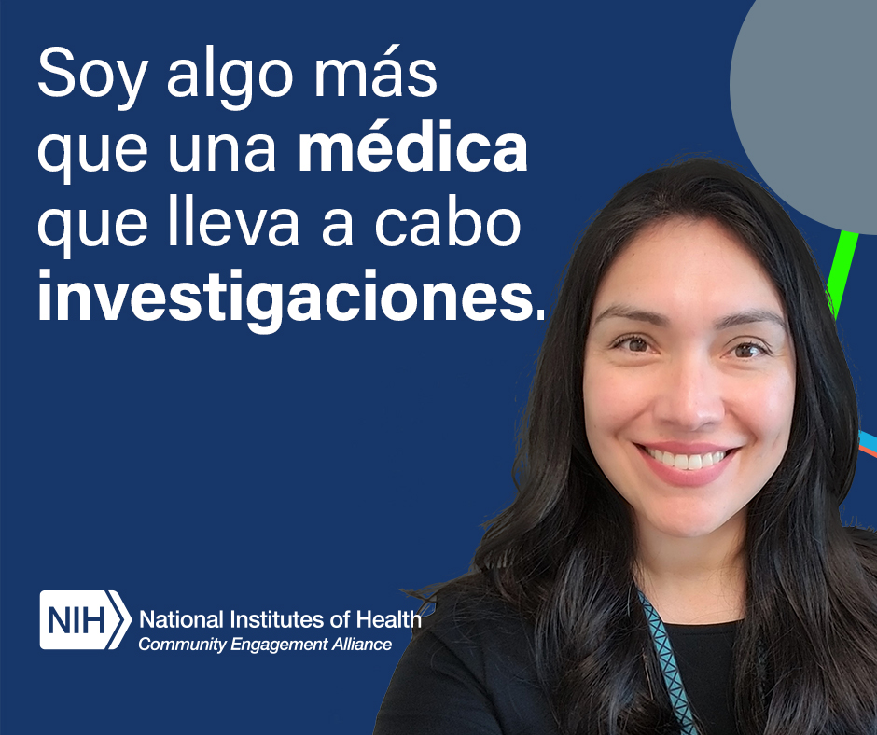
Dr. Katya Corado RESEARCHER
18
POST COPY – SPANISH
Facebook/LinkedIn
Esta es la doctora Katya Corado. Ella es una vecina que comparte con su comunidad cómo funcionan la ciencia y las vacunas contra el COVID-19. Aprenda más sobre la diversidad en la ciencia contra el COVID-19: https://go.usa.gov/xHjBZ
Twitter Copy 1
Esta es la doctora Katya Corado. Ella es una vecina que comparte con su comunidad cómo funcionan la ciencia y las vacunas contra el #COVID19. Aprenda más sobre ella y otras personas que participan en el proceso desde el descubrimiento hasta el tratamiento: https://go.usa.gov/xHjBZ
Twitter Copy 2
Esta es la doctora Katya Corado. Ella es una vecina que comparte con su comunidad cómo funcionan la ciencia y las vacunas contra el COVID-19. Aprenda más sobre la diversidad en la ciencia contra el #COVID19: https://go.usa.gov/xHjBZ #NIHCEAL #ListosParaLaVacuna #NIHCEAL #VaccineReady
IMAGE OPTIONS
IMAGE ALT TEXT
Facebook/Twitter
El texto dice: “Soy más que una médica que lleva a cabo investigaciones”.
Gráficos del lado derecho: foto del Dra. Katya Corado con una ilustración abstracta de una molécula detrás.
Logotipo: La Alianza de Participación Comunitaria de los Institutos Nacionales de Salud (en inglés)
LinkedIn
Imagen de la Dra. Katya Corado que dice " Soy más que una médica que lleva a cabo investigaciones".
Download Facebook/LinkedIn image
Twitter image

Slide 19
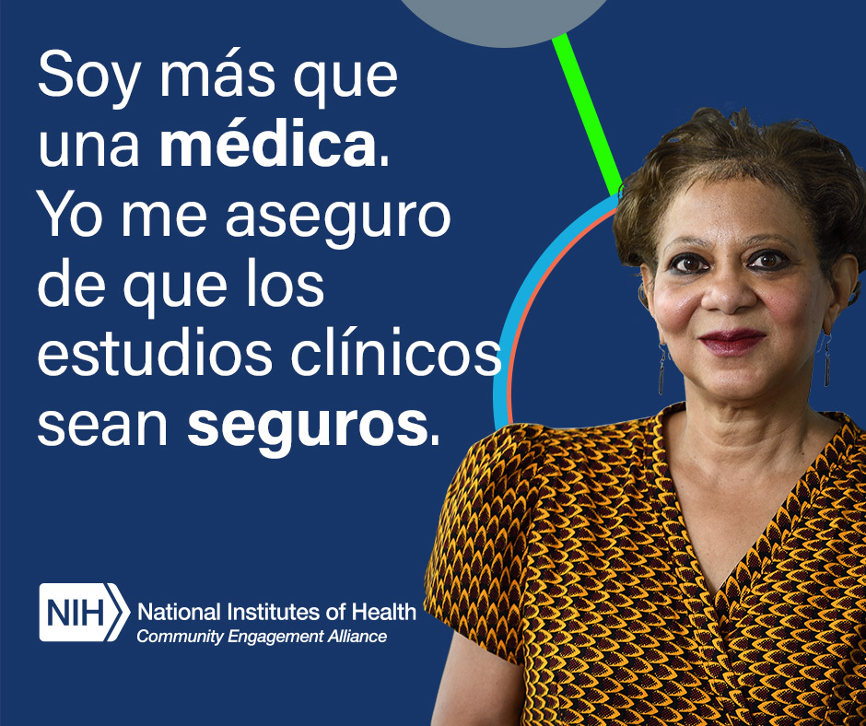
Dr. Lisa Cooper SAFETY MONITOR
19
POST COPY – SPANISH
Facebook/LinkedIn
La doctora Lisa Cooper, hija de un inmigrante liberiano, revisa los datos de las vacunas. Puede confirmar que las vacunas para nuestros padres son seguras. Aprenda más sobre la diversidad en la ciencia contra el COVID-19: https://go.usa.gov/xHjBZ
Twitter Copy 1
La doctora Lisa Cooper, hija de un inmigrante, revisa los datos de las vacunas. Puede confirmar que las vacunas para nuestros padres son seguras. Aprenda sobre las personas que participan en el proceso desde el descubrimiento hasta el tratamiento: https://go.usa.gov/xHjBZ
Twitter Copy 2
La doctora Lisa Cooper, hija de un inmigrante, revisa los datos de las vacunas. Puede confirmar que las vacunas para nuestros padres son seguras. Aprenda más sobre la diversidad en la ciencia contra el #COVID19: https://go.usa.gov/xHjBZ #NIHCEAL #ListosParaLaVacuna
IMAGE OPTIONS
IMAGE ALT TEXT
Facebook/Twitter
El texto dice: “Soy más que una médica. Yo me aseguro de que los estudios clínicos sean seguros”.
Gráficos del lado derecho: foto del Dra. Lisa Cooper con una ilustración abstracta de una molécula detrás.
Logotipo: La Alianza de Participación Comunitaria de los Institutos Nacionales de Salud (en inglés)
LinkedIn
Imagen de la Dra. Cooper que dice “Soy más que una médica. Yo me aseguro de que los estudios clínicos sean seguros”.
Download Facebook/ LinkedIn image
Twitter image

Slide 20
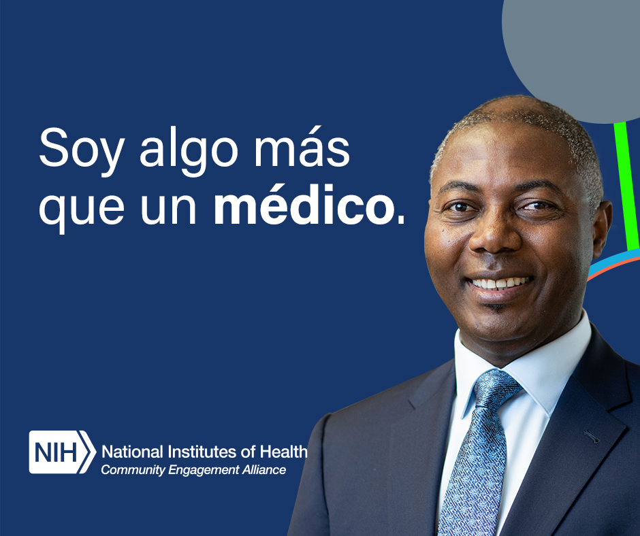
Dr. Chyke Doubeni CARE PROVIDER
20
POST COPY – SPANISH
Facebook/LinkedIn
El Dr. Doubeni participó en un estudio del COVID-19. Él ahora puede abordar de primera mano las inquietudes de sus pacientes. Aprenda sobre él y las otras personas que participan en el proceso desde el descubrimiento hasta el tratamiento: https://go.usa.gov/xHjBZ
Twitter Copy 1
El doctor Chyke Doubeni es nigeriano americano y se participó en un estudio del COVID-19. Él ahora puede abordar de primera mano las inquietudes de sus pacientes. Aprenda más sobre la diversidad en la ciencia contra #COVID19: https://go.usa.gov/xHjBZ #NIHCEAL
Twitter Copy 2
El doctor Chyke Doubeni es nigeriano americano y participó en un estudio del COVID-19. Él ahora puede responder mejor a las inquietudes de sus pacientes. Aprenda sobre las personas que participan en el proceso desde el descubrimiento hasta el tratamiento: https://go.usa.gov/xHjBZ
IMAGE OPTIONS
IMAGE ALT TEXT
Facebook/Twitter
El texto dice: “Soy más que un médico”.
Gráficos del lado derecho: foto del Dr. Chyke Doubeni con una ilustración abstracta de una molécula detrás.
Logotipo: La Alianza de Participación Comunitaria de los Institutos Nacionales de Salud (en inglés)
LinkedIn
Imagen del Dr. Chyke Doubeni que dice "Soy más que un médico". La Alianza de Participación Comunitaria de los NIH.
Download Facebook/LinkedIn image
Twitter image

Slide 21
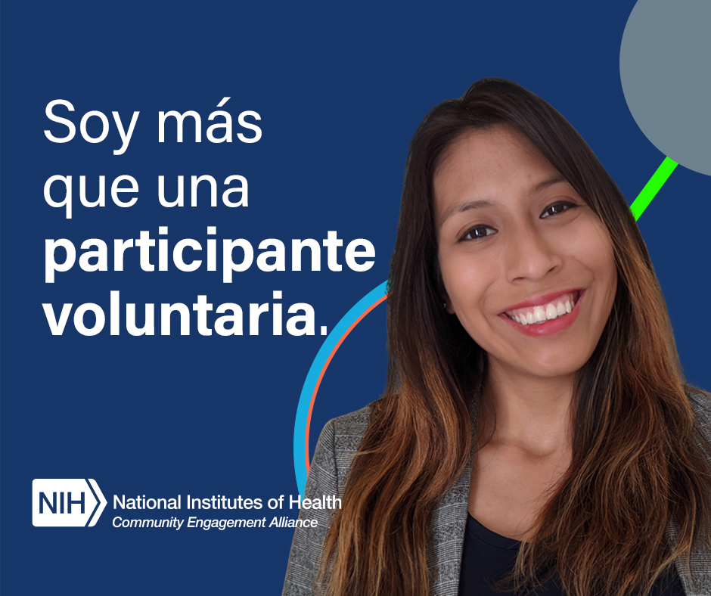
Emelina Asto-Flores VOLUNTEER
21
POST COPY – SPANISH
Facebook/LinkedIn
Emelina Asto-Flores es peruano americana y se ofreció como voluntaria para un estudio clínico e inspiró a su abuela a vacunarse. Aprenda más sobre ella y otras personas que participan en el proceso desde el descubrimiento hasta el tratamiento: https://go.usa.gov/xHjBZ
Twitter Copy 1
Emelina Asto-Flores es peruano americana y se ofreció como voluntaria para un estudio clínico e inspiró a su abuela a vacunarse. Aprenda más sobre ella y otras personas que participan en el proceso desde el descubrimiento hasta el tratamiento: https://go.usa.gov/xHjBZ #NIHCEAL
Twitter Copy 2
Emelina Asto-Flores es peruano americana y se ofreció como voluntaria para un estudio clínico e inspiró a su abuela a vacunarse. Aprenda más sobre la diversidad en la ciencia contra el #COVID19: https://go.usa.gov/xHjBZ #NIHCEAL #ListosParaLaVacuna
IMAGE OPTIONS
IMAGE ALT TEXT
Facebook/Twitter
El texto dice: “Soy más que una participante voluntaria”.
Gráficos del lado derecho: foto de Emelina Asto-Flores con una ilustración abstracta de una molécula detrás.
Logotipo: La Alianza de Participación Comunitaria de los Institutos Nacionales de Salud (en inglés)
LinkedIn
Imagen de Emelina Asto-Flores que dice “Soy más que una participante voluntaria”.
Download Facebook/LinkedIn image
Twitter image

